Slide 1
MBA532 – AI in Business
MODULE 2 – Defining and Clarifying AI and Machine Learning Concepts

Slide 2
The Broad AI/Machine Learning Domain
The Broad AI/Machine Learning Domain

Slide 3
What is an AI System? OECD Definition
OECD (Organization for Economic Cooperation and Development) defines an AI system as follows:
An AI system is a machine-based system that, for explicit or implicit objectives, infers, from the input it receives, how to generate outputs such as predictions, content, recommendations, or decisions that can influence physical or virtual environments. Different AI systems vary in their levels of autonomy and adaptiveness after deployment

Slide 4
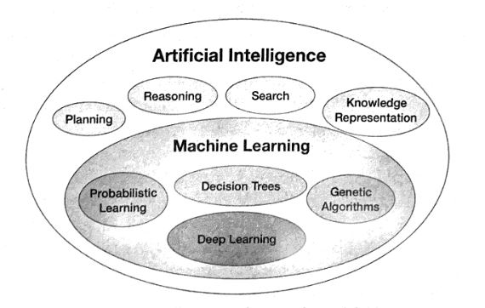
AI And Some of Its Subfields
A handy way to think about the embedded relationships among concepts such as deep learning, machine learning and AI is the Venn diagram below.
AI includes machine learning, but also includes, for example, algorithms or other knowledge that is hand-coded or built by traditional programming techniques rather than learned.
Machine learning includes any technique that allows a machine to learn from data; deep learning is the best-known among those techniques, but not the only one.

Slide 5
Overview of Today’s AI, Machine Learning, Deep Learning
In general, AI denotes software and machines that together demonstrate equal or better-than-human-level performance effectiveness at tasks.
Improvements in the field of computer vision and audio/text analysis led to the introduction of deep learning in 2012. Deep learning consists of layered Artificial Neural Networks (ANNs) to produce a richer understanding of tasks, leading to more accurate and nuanced recommendations/predictions when compared to basic machine learning.
An influential book (Digital Transformation, Siebel 2019) increases our understanding of the relationships between computing capabilities and AI abilities. Siebel identified four key technologies that both drive and enable digital transformation: Elastic cloud computing, Big Data, AI and IoT. Recent AI advances integrate these technologies with advances in computer vision, neural networks and Natural Language Processing (NLP).

Slide 6
AI deployment in Business, some examples
Alibaba recommends products; Google targets appropriate ads that we are more likely to click on, and YouTube can suggest videos we are more likely to watch. All these examples depend heavily on Recommender Systems powered by AI Algorithms,
Jinri Toutiao’s AI engines search the internet for content, using natural language processing and computer vision to digest articles and videos from its partner sites. It then analyses data of its users to curate a personalized newsfeed for each person.
Business AI exploits the fact that traditional AI has labeled data for decades. AI models trained using labeled data get insights that the human eye cannot figure out.
Within judicial AI systems, an evidence cross reference system uses speech recognition and natural language processing to compare all the evidences presented to identify any contradictions.
Swarms of AI-based autonomous drones can work together to paint the exterior of homes, fight forest fires, monitor and attack enemy terrain or conduct rescue operations more efficiently.
Point to Ponder: After one robot or AI agent has been trained, a huge benefit is that training can be instantly and effortlessly propogated to a very large number of other robots or AI agents.
Notes:
AI Superpowers China, Silicon Valley and the New World Order

